Slide 1
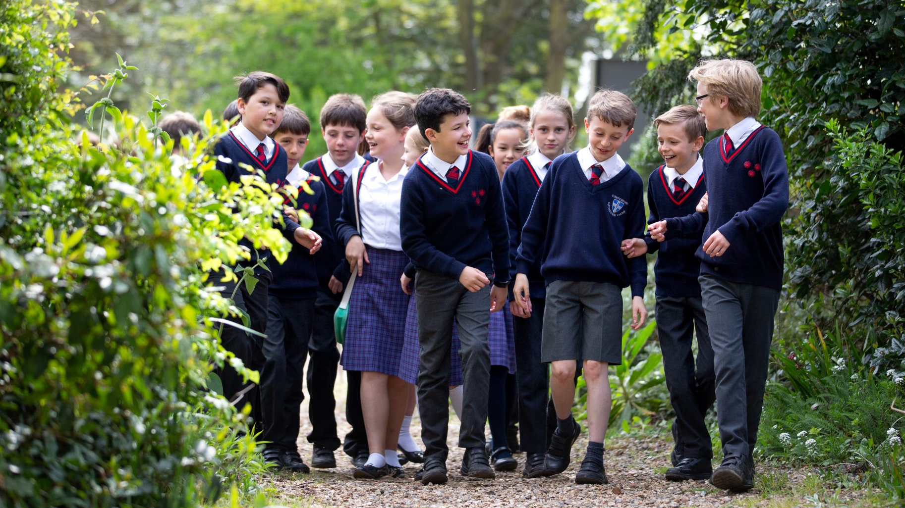
Junior School Deputy Head From September 2021

Slide 2
Letter from the Head of the Junior School Andrew De Silva
Dear Colleague,
Thank you for your interest in the post of Deputy Head at St Edmund’s Junior School from September 2021. This is certainly a very exciting time for the Junior School, and indeed the wider school family. Having myself recently started as Head of the Junior School, I am incredibly impressed with the family ethos of the school. There is a tangible sense of pastoral care and pride in the children, and, whilst it is important that this continues to be a strength, I believe that we must embrace the very best educational practices from around the world, so that we can provide our children with world-class educational provision.
I am looking for an outstanding teacher to bring ideas – either from the state or independent sector – and to learn, not only from me and the other members of SLT, but from our governors, staff, families and pupils.
This is an exciting role, which will provide you with opportunities to improve the quality of educational provision, organise aspects of the day-to-day practice of the school, get to know the children through class cover as required, and be fully involved in the life of the school. You will have responsibilities in the following key areas of school leadership (please note that this role may well include aspects throughout the 3-18 nature of the school):
Shaping the future
Leading Learning and Teaching, including
Examinations, Assessment and Reporting
Curriculum
Learning and Learning Behaviours
Developing self and working with others
Managing the Organisation
Securing Accountability
Strengthening Community
As an experienced Head, I am looking for someone to share in the journey. This pack will detail the expectations of the role and the requirements of the successful candidate, but I am looking for a passionate educator, who is child-centred and driven to achieve the best academic results, whilst ensuring that we continue to develop well-rounded citizens of the future. The relationship between the Head and Deputy is one that is crucial to the success of the school, and I am looking forward to appointing the right person to work alongside me to help lead and develop the school into the future. If you wish to apply for the role, please email a covering letter, the attached Application Form and the School Visit Form to Sarah Hudson, Head of HR. Finally, may I wish you good luck with your application. Please do not hesitate to contact me if I can be of further assistance.
I look forward to receiving your application.
Mr Andrew De Silva

Slide 3
Main purpose To support and deputise for the Head Teacher in providing professional leadership for the school, in order to secure its success and improvement, ensure high quality education for all its children and improve standards of achievement.
Accountabilities
Shaping the Future
Support the Head in ensuring the vision for the school is clearly articulated, shared, understood and acted upon effectively by all.
Deputise for the Head in his absence.
Assist the Head in the marketing of the Junior School via: contributing to the management of the website and newsletter; hosting visiting parents; attendance at other marketing events, which may fall during holiday periods.
Work within the school community to translate the vision into agreed objectives and operational plans which will promote and sustain school improvement.
Demonstrate the vision and values in everyday work and practice.
Motivate and work with others to create a shared culture and positive climate (to be a role model for positivity).
Ensure creativity, innovation and the use of appropriate new technologies to achieve excellence.
Support the Head in ensuring that strategic planning takes account of the diversity, values and experience of the school and community at large.

Slide 4
Leading Learning and Teaching: To be an outstanding teacher and a Teaching and Learning specialist. Teaching commitment – this may well depend on the candidate due to their subject/age specialism, but essentially, this is a non-class based role. However, there will be a need to cover teaching as required.
Examinations, Assessment and Reporting
Support the Head in ensuring a consistent and continuous school-wide focus on pupils’ achievement, using data and benchmarks to monitor progress in every child’s learning
Implement an effective assessment framework
Oversee the arrangements for unit tests and internal exams, designing invigilation schedules and exam timetables, and disseminating them to pupils and staff, and ensuring that stationery is provided and exam rooms are prepared when needed
Make sure that unit test and exam results are all entered on PASS within the deadline stated
Oversee the Junior School’s Assessment policy
Oversee the Academic Review Card (ARC) system and chair ARC meetings in Upper (Years 6 to 8) and Lower Schools (Years 3 to 5), delegating follow-up actions as required by colleagues
Undertake analysis of exam results
Make sure all baseline data and test results are readily accessible on the school intranet
Oversee the placement of pupils into teaching sets and any subsequent review of sets (promotions, demotions, etc.)
Communicate promptly and effectively with parents on academic matters.
Curriculum
Determine, organise and implement a diverse, flexible curriculum
Support the Head in ensuring that learning is at the centre of strategic planning and resource management
Establish creative, responsive and effective approaches to teaching and learning
Lead, develop and enhance the teaching practice of others
Demonstrate and articulate high expectations
Support the Head in ensuring a culture and ethos of challenge and support where all pupils can achieve success and become engaged in their own learning
Carry out, through Heads of Department and Subject Co-ordinators, a curriculum review of each academic subject on an annual basis
This includes overseeing the review and development of Programmes of Study and Schemes of Work in the Junior School, monitoring the coherence, progression, breadth and balance of said schemes.
Behaviour and Learning behaviours
Support the Head in devising and implementing strategies which secure high standards of behaviour and attendance
Take a strategic role in the development of new and emerging technologies to enhance and extend the learning experience of pupils
Monitor, evaluate and review classroom practice and promote improvement strategies
Challenge underperformance at all levels and ensure effective corrective action and follow-up.

Slide 5
Developing Self and Working with Others
Treat people fairly, equitably and with dignity and respect, to create and maintain a positive school culture
Support the Head in building a collaborative learning culture within the school and actively engage with Pre-Prep and the Senior School, as well as feeder schools, to build effective learning communities
Support the Head in developing and maintaining effective strategies and procedures for staff induction, professional development and performance review
Support the Head in ensuring effective planning, allocation, support and evaluation of work undertaken by teams and individuals, ensuring clear delegation of tasks and delegation of responsibilities
Acknowledge the responsibilities and celebrate the achievements of individuals and teams
Develop and maintain a culture of high expectations for self and for others and take appropriate action when performance is unsatisfactory
Establish and maintain a good relationship with the Senior School to ensure proper co-ordination of curriculum, staff and facilities
Oversee and administer the scholarship selection process and scholars’ programme
Regularly review own practice, set personal targets and take responsibility for own personal development
Manage own workload and that of others to allow an appropriate work/life balance.

Slide 6
Managing the Organisation
Support the Head in creating an organisational structure which reflects the school’s values, and enables the management systems, structures and processes to work effectively in line with legal requirements
Production of the School calendar
Administrative responsibility for SLT meetings
Logistical management of key school events (e.g. Open Days, St Edmund’s Day, Carol Service, Speech Day)
Production and implementation of clear, evidence-based improvement plans and all policies and procedures for the development of the school and its facilities, so that the school is fully compliant with ISI regulatory requirements, including Teaching and Learning, Marking and Feedback and Behaviour.
Liaison with colleagues from both the Pre-Prep and the Senior School over key areas of school management, attendance at “whole school” events and Pre-Prep or Senior School events as agreed with the Head.
Work with the Head of Co-Curricular to coordinate and manage the Educational Visits programme
Ensure that, within an autonomous culture, policies and practices take account of national and local circumstances, policies and initiatives
Support the Head in managing the school’s financial and human resources effectively and efficiently to achieve the school’s educational goals and priorities
Support the Head in recruiting, retaining and deploying staff appropriately and managing their workload to achieve the vision and goals of the school
Support the Head in implementing successful performance management processes with all staff
Support the Head in managing and organising the school environment efficiently and effectively to ensure that it meets the needs of the curriculum and health and safety regulations
Ensure that the range, quality and use of all available resources is monitored, evaluated and reviewed to improve the quality of education for all pupils and provide value for money
Use and integrate a range of technologies effectively and efficiently to manage the school
Monitor the liaison between Heads of Departments and Lower School Subject Co-ordinators
Manage and organise teams throughout the school – e.g. the lunchtime team
Encourage staff to take heed of IEPs for children with learning difficulties and to offer extension work for gifted and talented children
Be the delegated manager for the day-to-day Health and Safety needs of the school with the Head Teacher
Support the Head as a deputy DSL
Support the Head by listening, following advice and guidance, being proactive about feedback and actions and being a partner for school improvement.

Slide 7
Securing Accountability
Support the Head in fulfilling commitments arising from contractual accountability to the Governing Body
Support the Head in developing a school ethos which enables everyone to work collaboratively, share knowledge and understanding, celebrate success and accept responsibility for outcomes
Support the Head in ensuring individual staff accountabilities are clearly defined, understood and agreed and are subject to rigorous review and evaluation
Work with the Governing Body (providing information, objective advice and support) to enable it to meet its responsibilities
Develop and present a coherent, understandable and accurate account of the school’s performance to a range of audiences including governors, parents and carers
Reflect on personal contribution to school achievements and take account of feedback from others
Produce and update the Staff Handbook
Manage cover arrangements for absent staff
Record keeping and management of staff absence
Management of the Junior School’s Inset arrangements
Management of the staff CPD and appraisal process.

Slide 8
Strengthening Community
Build a school curriculum which takes account of the richness and diversity of the school’s communities, and to link this seamlessly with the Pre-Prep and Senior School
Create and promote positive strategies for challenging racial and other prejudice and dealing with racial harassment
Ensure learning experiences for pupils are linked into and integrated with the wider community
Oversee and moderate where necessary the demands made of Cathedral Choristers and ensure that individuals are not overloaded. Ensure that their special circumstances and needs are met, and especially that they receive appropriate support on the frequent occasions when they miss school
Ensure a range of community-based learning experiences
Collaborate with other agencies in providing for the academic, spiritual, moral, social, emotional and cultural well-being of pupils and their families
Create and maintain an effective partnership with parents and carers to support and improve pupils’ achievement and personal development
Seek opportunities to invite parents and carers, community figures, businesses or other organisations into the school to enhance and enrich the school and its value to the wider community
Contribute to the development of the education system by, for example, sharing effective practice, working in partnership with other schools and promoting innovative initiatives – in line with the House of Commons Briefing paper of Charitable status
Co-operate and work with relevant agencies to protect children, including being a deputy Designated Safeguarding Lead
Forge good relationships with the parent body, including support to the Parents Association and events arranged
Play an active role in the life of the school
Provide support to the boarding community of St Edmund’s Junior School (School House and Choir House), often out of conventional working hours (see Conditions of Service, below)
Promote the 3 – 18 ethos of the school.
In addition, during the absence of the Head, the post holder will be required by the Head or the Governing Body, to undertake professional duties of the Head to ensure the effective day-to-day management of the school.

Slide 9
Person Specification
 | Essential | Desirable
Qualifications | Qualified Teacher Status | Further professional study and qualifications School Leadership qualification e.g. MA, NPQH
The Classroom - being a ‘teaching and learning coach’ | Evidence of outstanding and creative classroom practice with the skills to develop this in others Able to demonstrate high standards of teaching and effective pupil learning in all areas of the curriculum Evidence of meeting the needs of all pupils Passion for making learning experiences exciting, memorable and fun Evidence of positive behaviour management Knowledge of the individual and diverse ways that children learn and develop Ability to build excellent relationships with children | Experience of working in more than one school Experience across the whole primary/preparatory age range
Leadership qualities and competencies | Able to lead and inspire the whole school community in all areas of school improvement Positive attitude with a clear vision, passion and conviction for Primary Education Excellent organisational and management skills including effective time management, e.g. creating whole school timetable and ensuring its effective implementation Experience of effective working with the Head, senior leaders and governors Experience of effective monitoring and self-evaluation Evidence of the impact of proven strong leadership skills Experience of effective core subject or whole school assessment leadership and/or whole school curriculum development Experience of leading CPD High level of literacy and attention to detail Experience of accountability within leadership Effective communication with all members of the school community including governors and parents Evidence of reporting school progress e.g. to governors Knowledge and understanding of ISI regulations and compliance High expectations of self, of pupils and of staff, seeking to fulfil their potential Effective experience of coaching and mentoring The ability to develop initiative in an imaginative and exciting way and successfully finish what has been started within an agreed timeframe Ability to work with other professionals within and beyond the setting | Currently in a leadership role Experience of leading the Performance Management process Evidence of subject/initiative leadership impact Experience of leading intervention Experience of monitoring and moderation of work Experience of line managing teams of staff, e.g. LSAs, teachers, lunchtime support staff Currently a deputy DSL
Personal Qualities | Committed to children A partner for the Head – being a good listener, who is loyal, honest and trustworthy Recognises when to seek advice and support and is prepared to do so Reflective, creative and innovative Has professional integrity - displays a constructive and optimistic attitude that has a positive effect on others Able to evidence their outstanding impact on teaching and learning, both as a teacher and as a leader Has excellent interpersonal skills and a presence which inspires confidence and commands respect from all members of the St Edmund’s School family Able to motivate, engage and develop high aspirations in themselves, in pupils and in staff Committed to all aspects of school – willing and able to be flexible Able to work as a team member of SLT Able to evidence impact of leadership Is approachable and caring A generosity of spirit towards the demands of a busy school, as the role requires flexibility and will involve out of hours, weekend and holiday work Professional in their relationships with children, staff and parents and has a good sense of humour! | Able to evidence impact of leadership AND management

Slide 10
Conditions of service
Salary Scale: £47,509 - £52,473
The school is a member of the Teachers’ Pension Scheme and it is assumed that all teaching staff will continue as members of this pension scheme unless they inform the school otherwise.
Fee remission is available for all staff according to discretion of the governors, subject to change/withdrawal.
Lunch is offered free-of-charge for all staff whose working hours encompass the time of school lunch and who accept the necessary supervisory role of staff and pupils during this period.
All members of staff are expected to contribute to the wider life of the school community and fulfil the role of a form tutor. All full-time members of staff contribute to the games and/or activities programmes. All Junior School teaching staff contribute to the Junior Boarders’ Saturday morning programme and new members of staff are expected to complete one night’s boarding duty per week for one term in their first year of service. Members of the Junior School SLT are also expected to contribute to the emergency cover rota for Junior Boarding.
St Edmund’s School Canterbury is committed to safeguarding and promoting the welfare of children, and applicants must be willing to undergo child protection screening appropriate to the post, including checks with past employers and the Disclosure and Barring Service (DBS).

Slide 11
Assessment Process
The role of Deputy Head at the Junior School is incredibly important to our community. As such, it is vital that we get the right candidate, so I urge all applicants to look carefully through the job description and the person specification. In order to ensure that the best candidate is appointed, the assessment process is rightly robust. Once applications have been received, longlisting will take place. I will then visit schools to observe the following (please seek out permission from your current Head):
Teaching and Learning observation for 30 minutes in English or Maths. Please have a selection of books available for me to look through, so that I can see the level of feedback over time.
10 minute conversation with a colleague the applicant has mentored/coached.
Tour of the school, focusing on the applicant’s impact on teaching and learning.
After my visits, I will then shortlist with the panel for a 2 day interview process to be held at St Edmund’s School.
All potential candidates are welcome to speak to Mr De Silva over TEAMS. If you are touring, you will need to adhere to our COVID protocols. To arrange a TEAMS meeting/tour, please liaise with The Junior School Secretary, Mrs King by phoning 01227 475606 or by emailing yk@stedmunds.org.uk.
 | Date | Action
Junior School Tours |  | Email yk@stedmunds.org.uk to request a TEAMs meeting/tour
Closing Date for applications | 5th March 2021 - Midday | Email Covering Letter, Application Form (including Statement in Support of Application) and School Visit Form to Sarah Hudson (Head of HR): slh@stedmunds.org.uk
Long Listing | 5th March 2021 | Panel only
Mr De Silva visiting schools | 9-12th and 15th March 2021
Short Listing | 16th March 2021 | Panel only
Interview days | 24th & 25th March 2021 | Candidates will be required for both days
Personal information provided by candidates will be kept on a secure file in the school and will not be released to third parties outside the school without the permission of the person concerned, except where there is a legal requirement so to do.

Slide 12
